Slide 1

Time Series Forecasting

Slide 2
Agenda
Introduction
EDA
1
2
Modelling
Conclusion
3
4

Slide 3
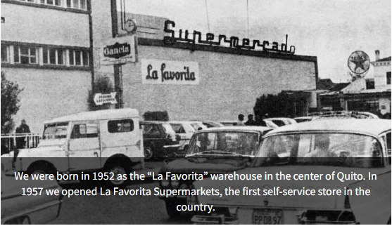


Background
1952
1983
March 28
Supermarket set into shopping malls
Line of business expanded so well
Quito
First Store - LA FAVORITA
1971-79
Rename Bodega La Favorita to Supermaxi
2008
Notes:
Ecuador

Slide 4
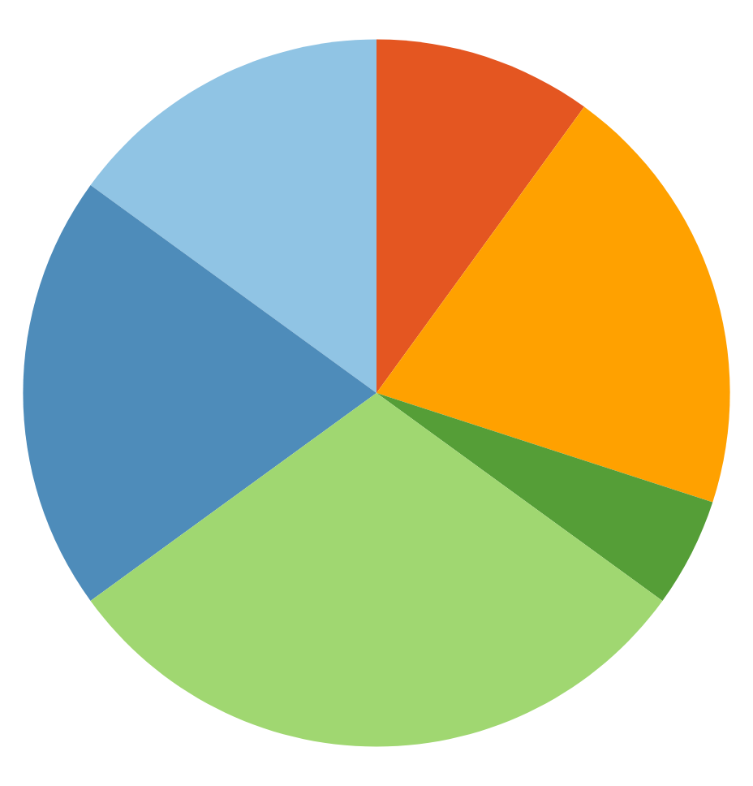
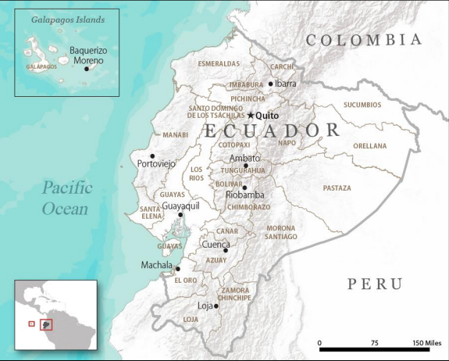
Figures of interest
54 Store
10,000
Throughout Ecuador
Employees
Corporación Favorita
16 State
288M
In Pichincha
Sales
Alone has 19 outlets
In 2015
70 Years
3M
We are committed to Ecuador and its development.
Customer
The client is our passion

Slide 5
Problem Statement
04
Forecasts
03
Especially relevant to brick-and-mortar grocery stores
Predict a little over, and grocers are stuck with overstocked, perishable goods.
Guess a little under, lost revenue and upset customers.
Apply machine learning to help Favorita buyer to ensure enough supplies to sell and not overstock.
02
01
80%
Notes:
Forecasts are especially relevant to brick-and-mortar grocery stores,
which must dance delicately with how much inventory to buy.
Predict a little over, and grocers are stuck with overstocked, perishable goods.
Guess a little under, and popular items quickly sell out, leading to lost revenue and upset customers.

Slide 6
EDA
2

Slide 7
Data Sets
Train & Test Set
3M Row
Holiday Set
350
Sales data since 2013 - 2017
Product Family
Store Code No.
Holiday Types and Nature
Since 2013 - 2017
Store & Transactions
83k
Oil Price
1175
Transaction data per store since 2013 - 2017
Store State Classifier, Claster
Daily oil price since 2013 - 2017

Slide 8
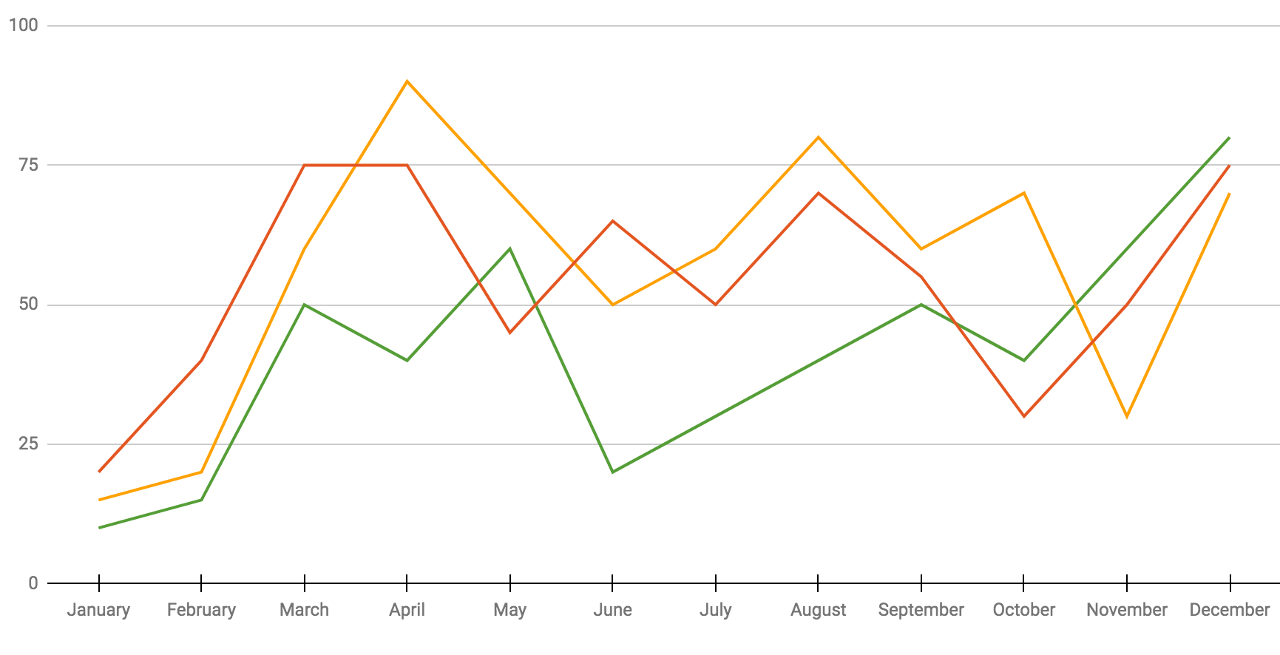
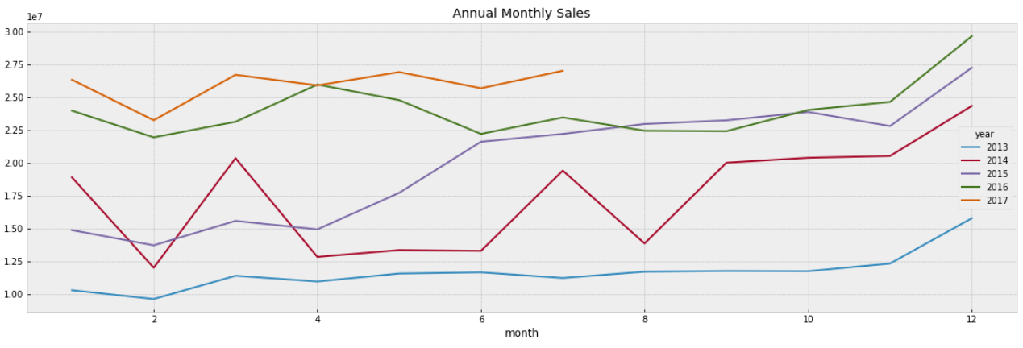
Sales by Annual
Annual Sales (M)
2014
209
2015
240
2016
288
Total sales increase
+ 16%

Slide 9
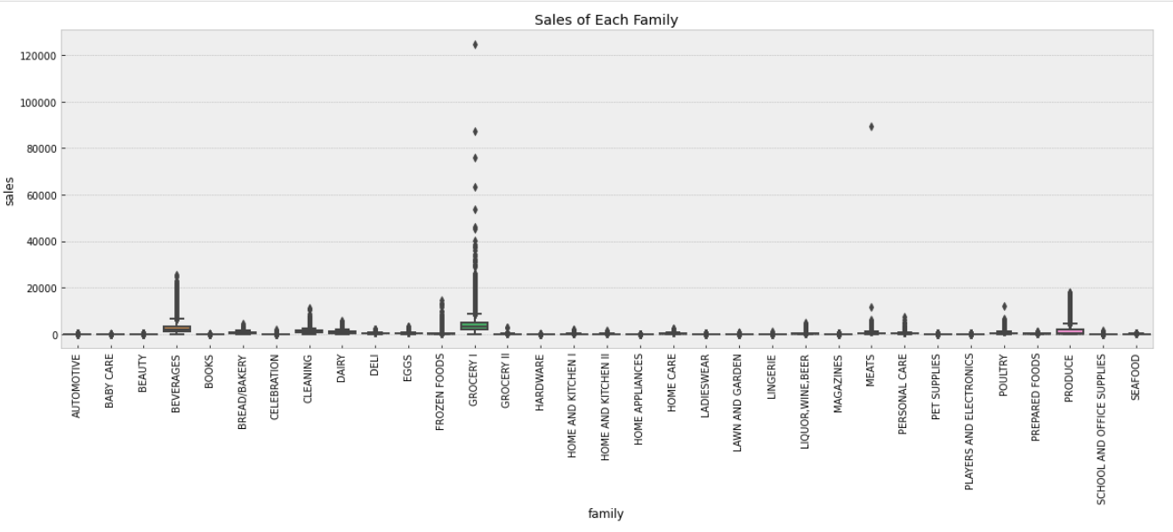
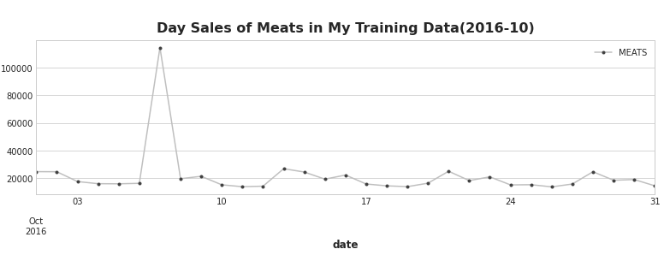
Sales by Product Family
Mercury
Jupiter
Best month
July
90%

Slide 10
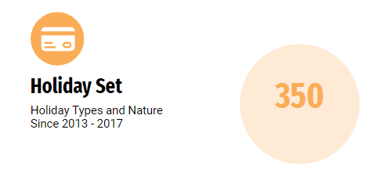
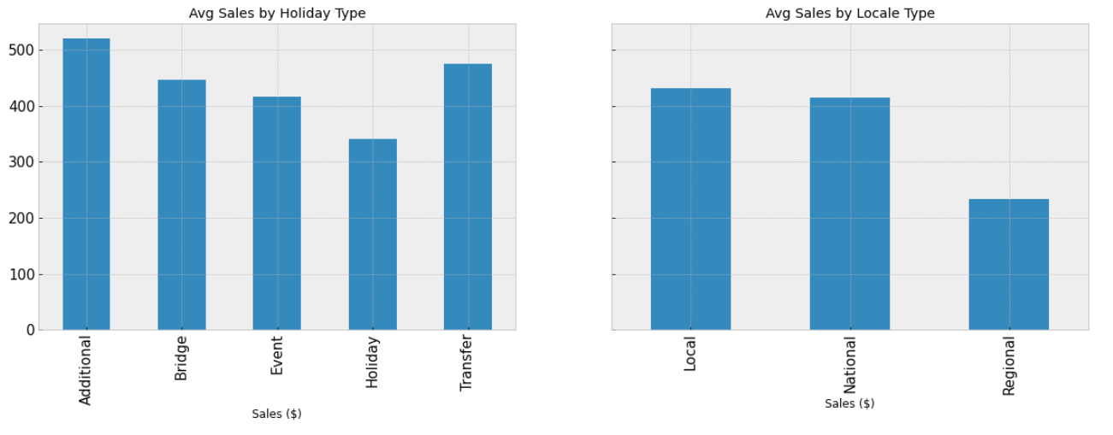
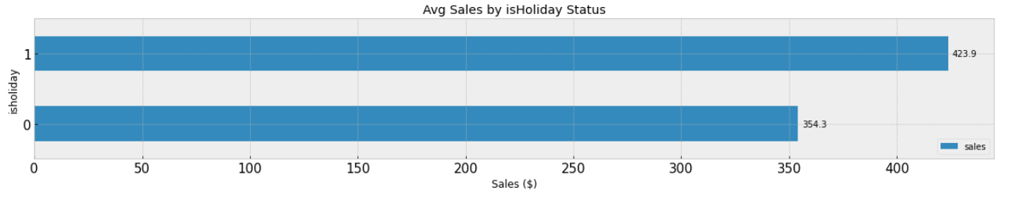
Sales During Holiday
Notes:
350 / 5 = 70 days

Slide 11
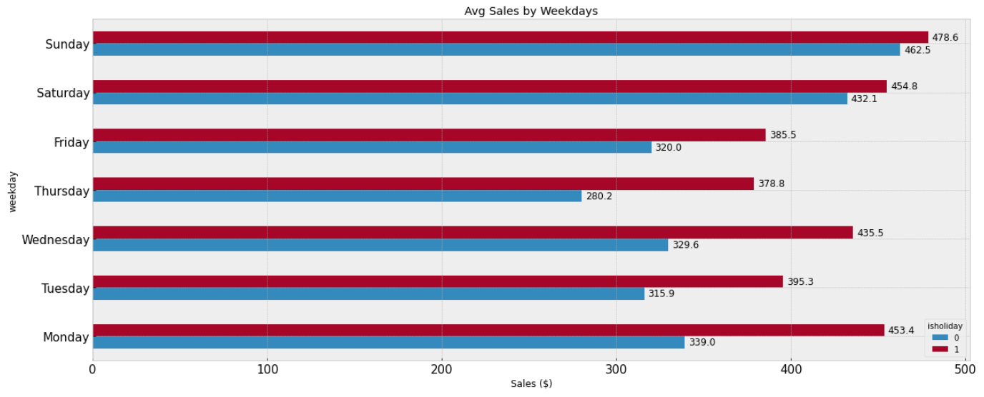
Avg Sales by Weekdays

Slide 12
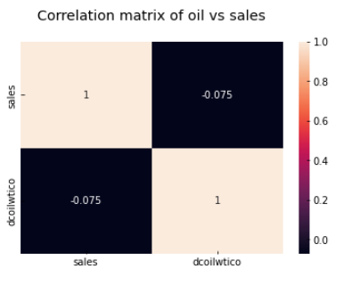
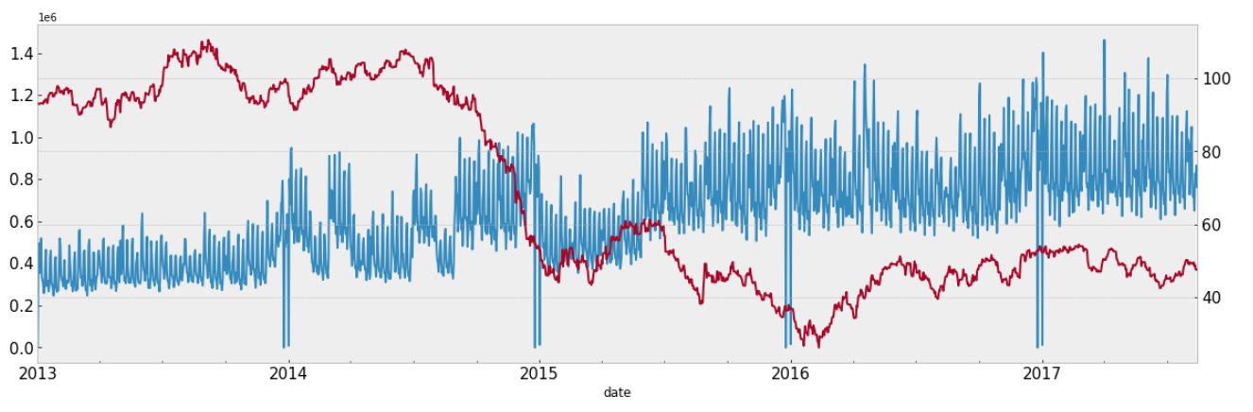
Sales vs Oil Price

Slide 13
Modelling
3

Slide 14
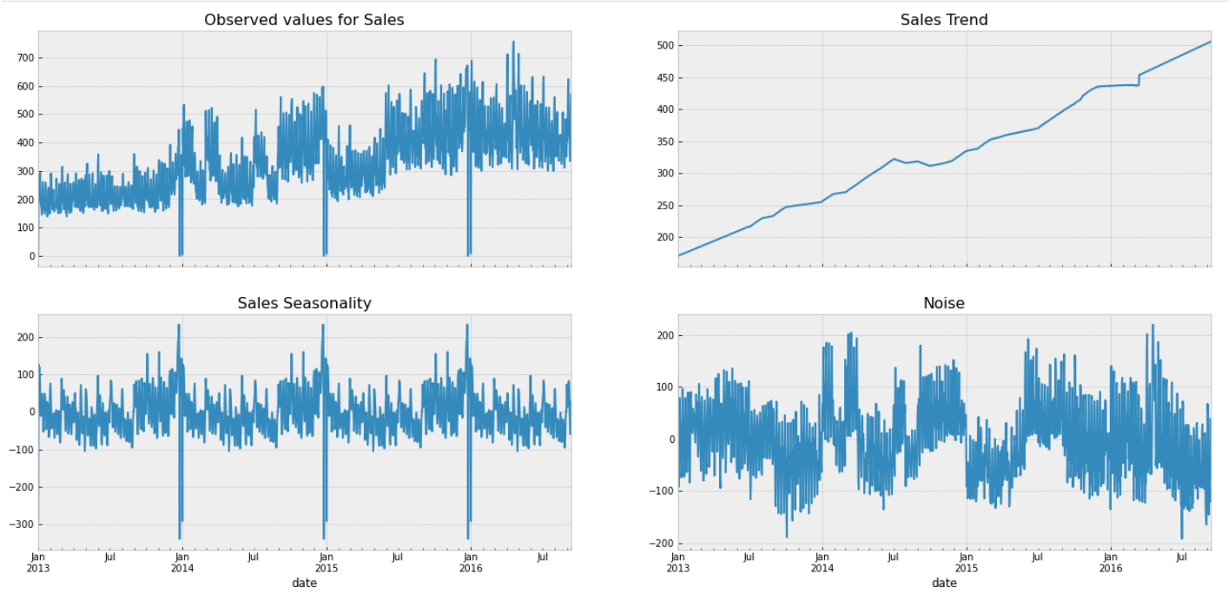
Pattern Recognition for Time Series
Up-trend
Seasonality
Notes:
The seasonal component explains the periodic ups and downs one sees in many data sets
The noise or the random component is what remains behind when you separate out seasonality and trend from the time series. Noise is the effect of factors that you do not know, or which you cannot measure. It is the effect of the known unknowns, or the unknown unknowns.

Slide 15
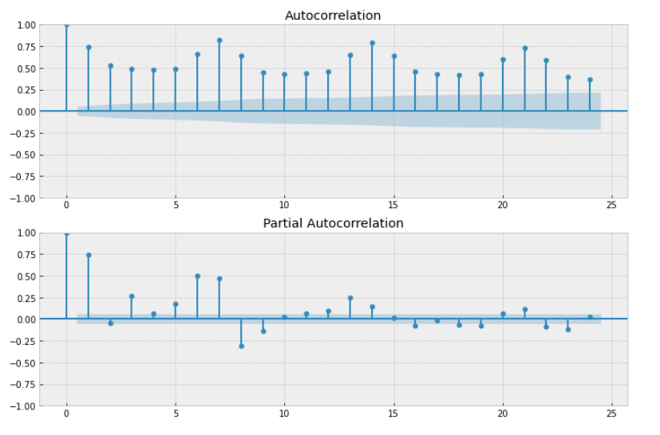
Correlogram
Notes:
A correlogram (also called Auto Correlation Function ACF Plot or Autocorrelation plot) is a visual way to show serial correlation in data that changes over time

Slide 16
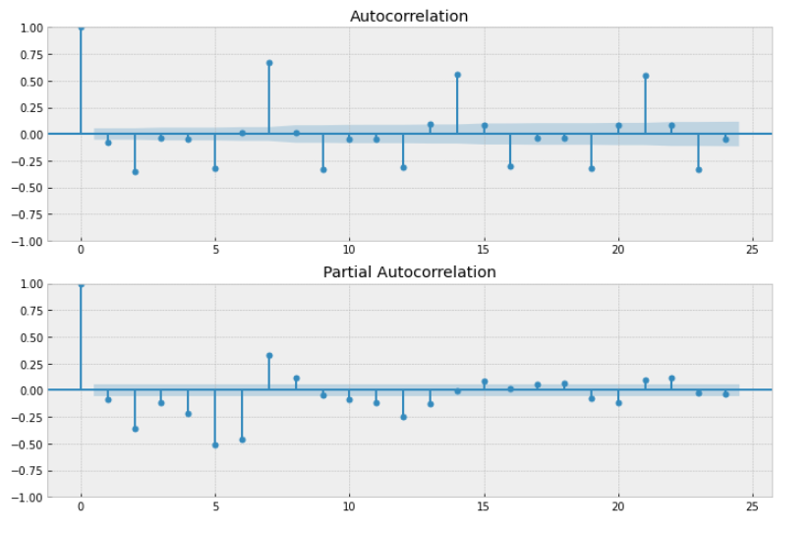
Correlogram
Notes:
A correlogram (also called Auto Correlation Function ACF Plot or Autocorrelation plot) is a visual way to show serial correlation in data that changes over time

Slide 17
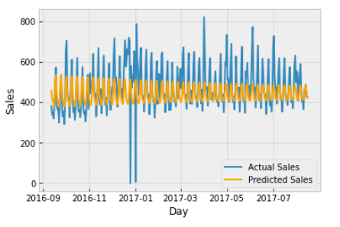
Model 1 - ARIMA
RMSLE
0.4402
AutoRegression Moving Average
Date & Sales Feature Only
Notes:
An autoregressive integrated moving average model is a form of regression analysis
Autoregression (AR): refers to a model that shows a changing variable that regresses on its own lagged, or prior, values.
Integrated (I): represents the differencing of raw observations to allow for the time series to become stationary (i.e., data values are replaced by the difference between the data values and the previous values).
Moving average (MA): incorporates the dependency between an observation and a residual error from a moving average model applied to lagged observations.

Slide 18
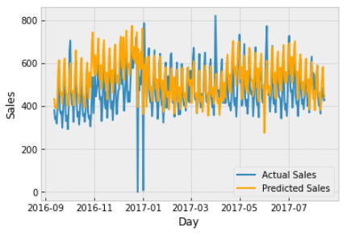
Model 2 - SARIMAX
RMSLE
0.4254
Seasonal AutoRegression Moving Average with eXogenous Factor
Date, Sales, Onpromotion, isHoliday Features
Notes:
An autoregressive integrated moving average model is a form of regression analysis
Autoregression (AR): refers to a model that shows a changing variable that regresses on its own lagged, or prior, values.
Integrated (I): represents the differencing of raw observations to allow for the time series to become stationary (i.e., data values are replaced by the difference between the data values and the previous values).
Moving average (MA): incorporates the dependency between an observation and a residual error from a moving average model applied to lagged observations.

Slide 19
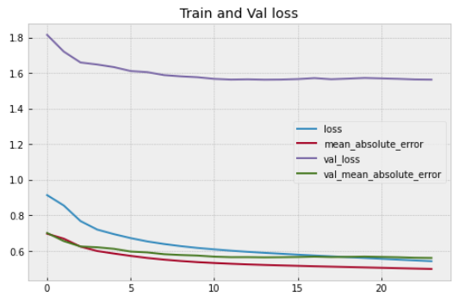
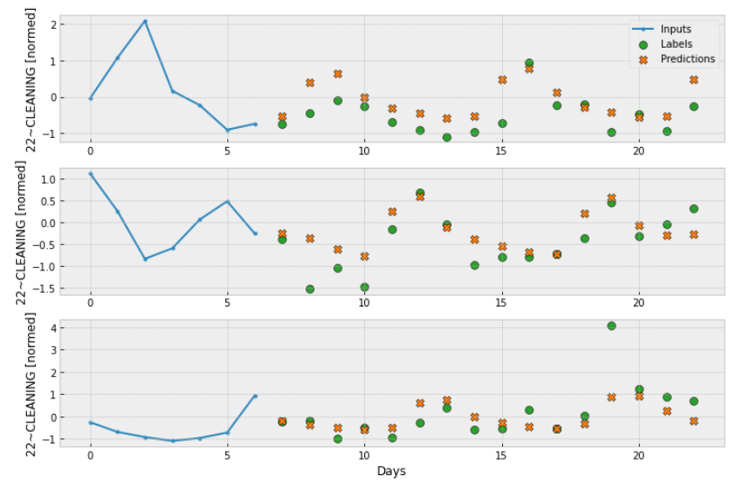
Model 3 - LSTM
RMSLE
0.564
Long short-term memory
Date, Sales, store, product family Features
Notes:
LSTM recurrent neural network
are a special kind of RNN, capable of learning long-term dependencies

Slide 20
Type of Modelling Used
ARIMA
SARIMAX
LSTM
01 | 02 | 03 | 04 | 05 | 06 | 07 | 08 | 09 | 10 | 11 | 12 | RSMLE | Modelling
 |  |  |  |  |  |  |  |  |  |  |  | 0.44 | ARIMA
 |  |  |  |  |  |  |  |  |  |  |  | 0.42 | SARIMAX
 |  |  |  |  |  |  |  |  |  |  |  | .564 | LSTM

Slide 21
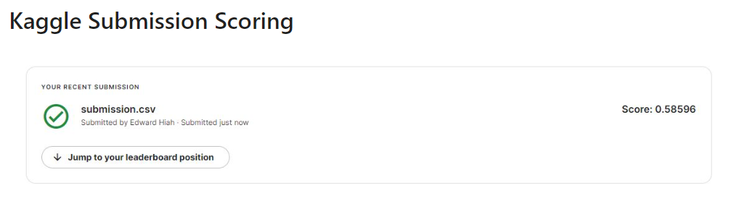
Kaggle Score

Slide 22
Conclusion
4

Slide 23
Conclusion
The best results are taken from Univariate LSTM (with rolling window of 1 year)
The SARIMA model outperformed the LSTM for the long term prediction task, but has it limitation to run by stores and product families.
LSTM model was more robust, although RMSLE wasn’t very good for Long window period but it did quite well if the window for 1 year.
Might be further consider XGBoost or LGBM or FB Prophet for further ML forecasting

Slide 24
End of Presentation
Thank You
2022

